Slide 1

Welcome To My
Presentation
Team : ACE

Slide 2
Problem Statement :
Improve Tourism Spot And Income Rate of Common People With Waste Management.

Slide 3
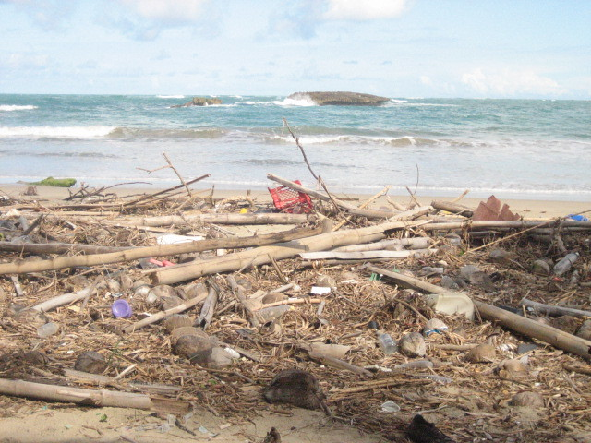
Why Does This Doesn’t Change??

Slide 4
SEASHORE and TOURISM
TOURIST have a special interest in seashore and beach
How can we improver their attraction
Proved a Clean Enviornment
Improve the lively Hood of Surrounding People.

Slide 5
Solution : ACE-Bin
The Concept is very simple.
Build multiple Bins.
But it has AR Technology Installed.
A-Bin : Aim Bin
C-Bin : Clean Bin
E-Bin : Entertainment Bin

Slide 6
A-Bin : Aim Bin
A Bin with little treats we like to have in Beach for affordable Rates.
Has an AR Technology Also to AIM on Famous spotes Loved by others in The Location.
Using Unity and 360 Viewer.

Slide 7
C-Bin : Clean Bin
A Bin to collect Waste both Organic and Inorganic.
Has an AR Technology Also to AIM the attraction of the Tourist with valuable information on the place and Culture.

Slide 8
E-Bin : Entertainment Bin
A bin purely oriented to be installed with the purpose of Entertainment.
This can a Deep Sea tour with AR.
Also an Interactive Game Hub.

Slide 9
Develope An application
Development of target based Applications.
Build using Unity
C#

Slide 10
Thank you ^_^

